Slide 1


Sentiment Analysis using Data Mining Techniques
BHANU SIVA KUMAR KOMMANA
JASWANTH GARIKIPATI
K RAVINDRA SAIBABA VEERARAGHAVA RAJU LOLABHATTU
PRUDHVINATH REDDY KATHA
PAVAN KUMAR REDDY KONDURU

Slide 2
Abstract
Sentiment analysis – vital technique in field of data science.
Knowing user’s opinion on texts and tweets made rise in using data mining techniques.
Twitter is the one of the main hubs in collecting textual data from users like., opinions, trends, and news.
Machine learning modules and data mining techniques can be used to gather emotions.
Notes:
Sentiment analysis has emerged as a vital technique in the quickly developing field of data analysis, helping businesses to comprehend the attitudes and feelings of their customers on a variety of platforms.
Due to the rise in usage of social media, knowing users’ opinion on texts and tweets made rise in using data mining techniques to identify emotions based on textual data.
Twitter is the one of the main hubs in collecting textual data from users like., opinions, trends, and news.
By using Machine learning modules and data mining techniques can be used to gather emotion on the latest trends, news, and tweets can help the so many marketing platforms or parties to know the opinion of their products or business.

Slide 3
INTRODUCTION
Sentiment analysis – uses NLP
Large amount of user review data is quite useful for the ecommerce websites to know the opinion.
Analysing and extracting sentiment from this textual data.
NLP techniques to extract emotion in an essay
Notes:
Sentiment Analysis also known as opinion mining is a major task in natural language processing (NLP) that focuses on converting normal text into emotions.
The large amount of user review data is quite useful for the ecommerce websites to know the opinion, attitude, and sentiment towards products, services, and events.
Analysing and extracting sentiment from this textual data will be helpful for all the websites, platforms, and products to get an idea of public opinion and to improve their business for better user support.
we will be using natural language processing in extracting information from text, and we'll be using this natural language processing to analyse emotions and sentiments of a given text or an essay.

Slide 4
WHY SENTIMENT ANALYSIS?
Sentiment analysis is used to gain valuable insights from textual data.
Enhance market and monitor their products
Better customer support and product quality
Marketing strategies
Notes:
Sentiment analysis is used to gain valuable insights into customer opinions and attitudes towards products, services, and events expressed in textual data.
Enhance market research by understanding customer preferences and sentiments.
Monitor social media for brand perception and customer feedback.
Improve customer support and product quality based on sentiment analysis insights.
Optimize marketing strategies and campaigns by tailoring messaging to match customer sentiments.
Identify emerging trends and sentiments in real-time to make informed business decisions.

Slide 5
Literature Review
Emotion Recognition by Textual Tweets Classification Using Voting Classifier (LR-SGD)
Previous studies have applied sentiment analysis to diverse domains, including marketing, political analysis, and social media analytics.
Wongkar and Angdresey conducted sentiment analysis using Twitter data
Notes:
The paper talks about how voting classifier, combining logistic regression (LR) and stochastic gradient descent (SGD) techniques ar
Wongkar and Angdresey conducted sentiment analysis using Twitter data to analyze public opinions on goods, services, political figures, and celebrities, achieving significant accuracy with classifiers like Naïve Bayes and Support Vector Machines. e used in recognizing emotions from textual data

Slide 6
PRODUCT VALUE
Customer Opinion
Improving product quality
Marketing strategies
Analysis
Notes:
Sentiment analysis helps businesses understand how customers feel about their products or services. By analyzing customer reviews and social media posts, companies can identify positive and negative sentiments, which provides insights into customer satisfaction and preferences and also they can enhance product quality and address customer concerns more effectively.
Businesses can tailor their messaging and advertisements based on customer sentiments to better resonate with their target audience.
This information helps businesses understand their competitive landscape and identify areas where they can differentiate themselves.

Slide 7
TECHNOLOGIES USED
VScode
PyCharm
NLTK library
PostgreSQL /My SQL
Matplotlib (Python Libraries)
Notes:
Vscode is a popular (IDE) supports various programming languages, including Python, which is commonly used for natural language processing (NLP) tasks like sentiment analysis.
PyCharm: PyCharm is another powerful IDE specifically designed for Python development.
NLTK library: the libraries provide various tools and functionalities for text preprocessing, tokenization, part-of-speech tagging, sentiment analysis, and more.
PostgreSQL / MySQL: used to store textual data, sentiment analysis results, and related metadata for analysis and retrieval.
Matplotlib (Python): In sentiment analysis projects, Matplotlib can be used to visualize sentiment distributions, emotion trends, and other analytical insights derived from textual data.

Slide 8
METHODOLOGIES
Data Collection
Text Preprocessing
Feature Extraction
Sentiment Classification
Model evaluation
Notes:
Data Collection: Compile a collection of opinion-expressing words or tweets.
Text Preprocessing: To clean and prepare the data, make use of NLTK's text processing features. This covers stop-word elimination, stemming, and tokenization.
Feature extraction: Look for the presence of important words or phrases that are frequently suggestive of sentiment by using NLTK.
Sentiment Classification: Use the built-in sentiment analysis features of NLTK, such VADER or custom classifiers, to classify each text or tweet according to its sentiment.
Model Evaluation: By contrasting the model's predictions with a manually labelled test set, you may determine how accurate the sentiment analysis using NLTK was

Slide 9
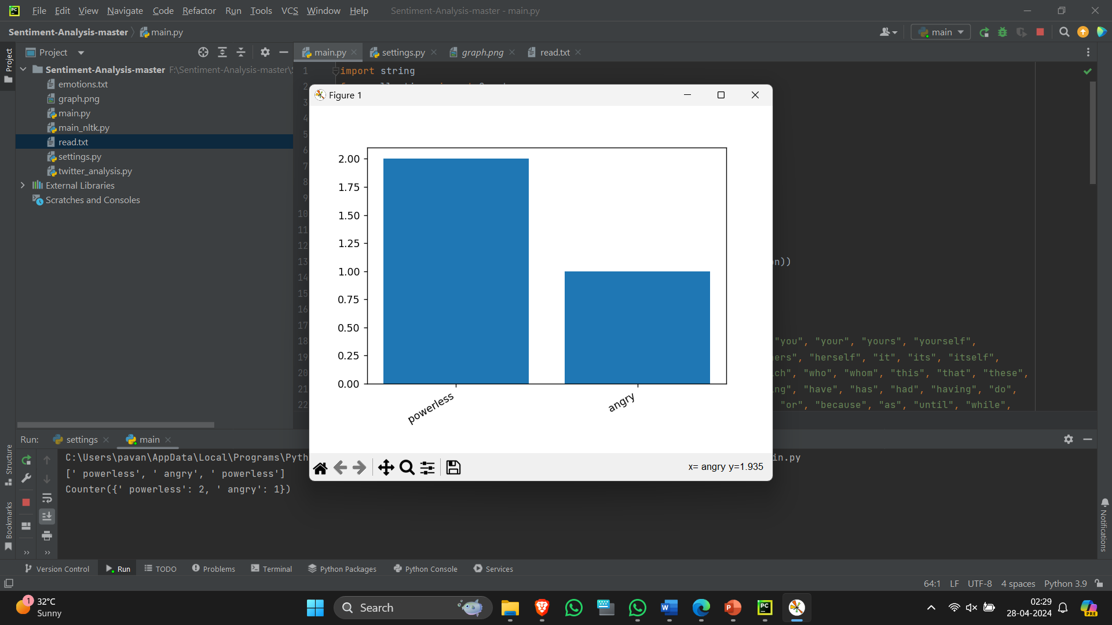
RESULTS
Notes:
This is our output page where in a given text input it recognizes the emotions present in the textaual data given. And also it will plot a graph of the emotions present in the text.

Slide 10
CONCLUSION
Sentiment analysis uses NLP techniques to recognize emotion.
Sentiment analysis, capable of accurately detecting and classifying emotions in text.
Enabling continuous monitoring of public sentiments on social media platforms and enhancing decision making.
Plot all these emotions on a graph according to how much these emotions are occurring.
Notes:
sentiment analysis is a powerful technique for extracting valuable insights from textual data. This project aims to develop an advanced NLP model for sentiment analysis, capable of accurately detecting and classifying emotions in text.
the project aims to extend sentiment analysis capabilities to real-time applications, enabling continuous monitoring of public sentiments on social media platforms and enhancing decision-making processes for businesses and researchers.
we can also plot all the emotions in an essay, or a big amount of text contains a lot of emotions and plot all these emotions on a graph according to how much these emotions are occurring

Slide 11
FUTURE WORK
01
Enhancing model performance
02
Addressing data quality issues
03
Exploring advanced NLP techniques to improve sentiment analysis accuracy.
Notes:
Enhancing model performance, addressing data quality issues, and exploring advanced NLP techniques to improve sentiment analysis accuracy.

Slide 12
REFERENCES
A. Yousaf et al., "Emotion Recognition by Textual Tweets Classification Using Voting Classifier (LR-SGD)," in IEEE Access, vol. 9, pp. 6286-6295, 2021, doi: 10.1109/ACCESS.2020.3047831. Emotion Recognition by Textual Tweets Classification Using Voting Classifier (LR-SGD)
Saberi, Bilal, and Saidah Saad. "Sentiment analysis or opinion mining: A review." Int. J. Adv. Sci. Eng. Inf. Technol 7.5 (2017): 1660-1666.Microsoft Word - 7. Bilal Saberi - 2137-Final (core.ac.uk)
Wongkar, Meylan, and Apriandy Angdresey. "Sentiment analysis using Naive Bayes Algorithm of the data crawler: Twitter." 2019 Fourth International Conference on Informatics and Computing (ICIC). IEEE, 2019.

Slide 13
Thank You..!
GROUP 12
bkomman1@kent.edu
jgarikip@kent.edu
klolabha@kent.edu
pkatha@kent.edu
pkonduru@kent.edu

